Slide 1
Chapter 6 Differential Analysis of Flow
CE30460 - Fluid Mechanics
Diogo Bolster

Slide 2
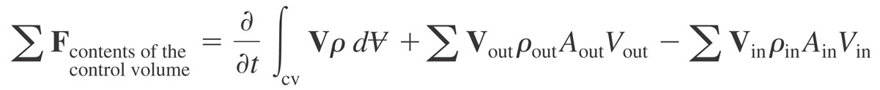

Conservation of Momentum
Newton’s Second Law
What forces act on a differential volume?

Slide 3

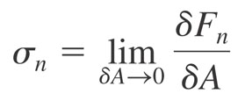
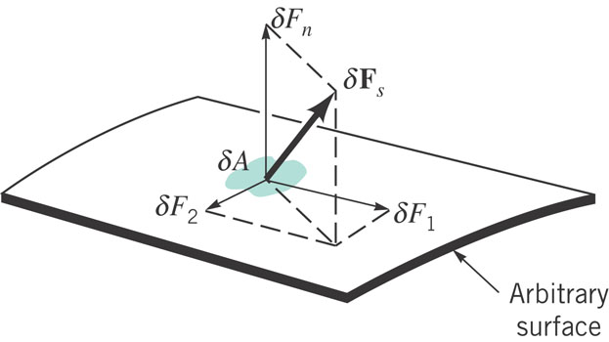


Forces on Differential Element
Weight (Vector)
Surface forces (normal and shear)

Slide 4
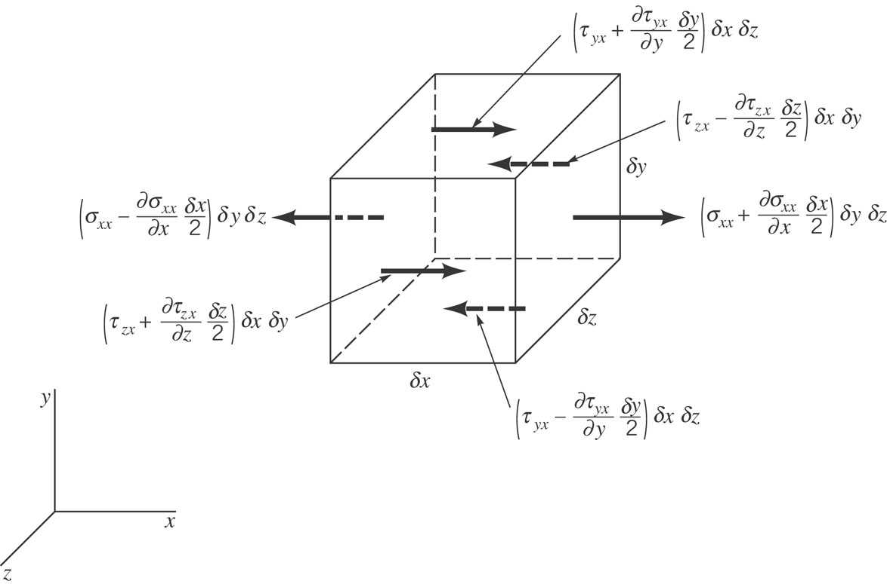
Surface Forces in x direction on a fluid element (same in other directions)

Slide 5
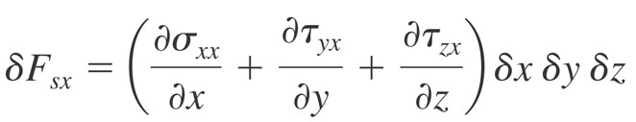
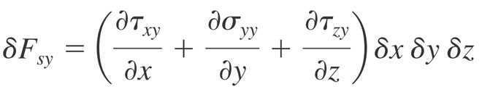
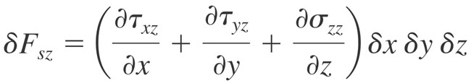
Therefore….

Slide 6
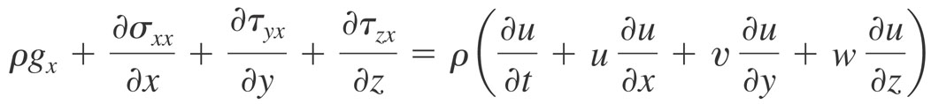
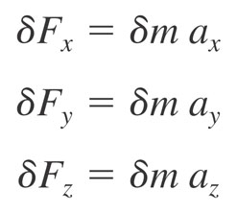
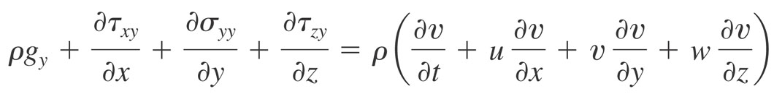
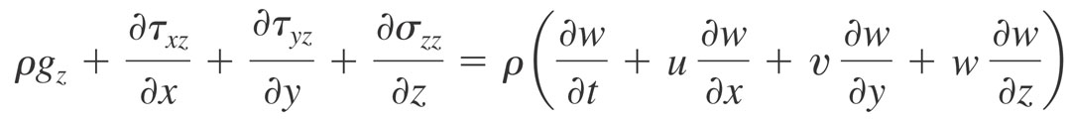
Newton 2 becomes

Slide 7
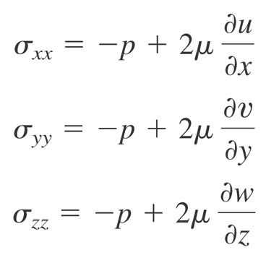
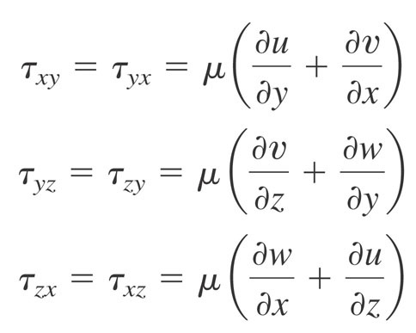
How do we treat stresses?

Slide 8
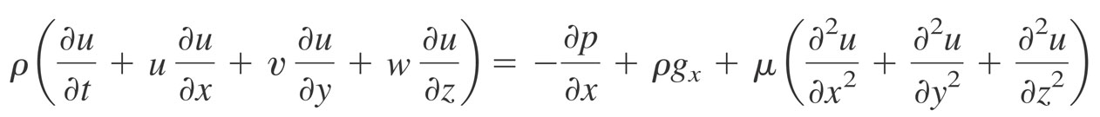
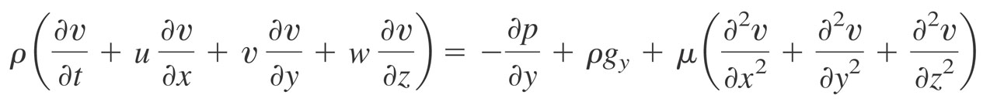
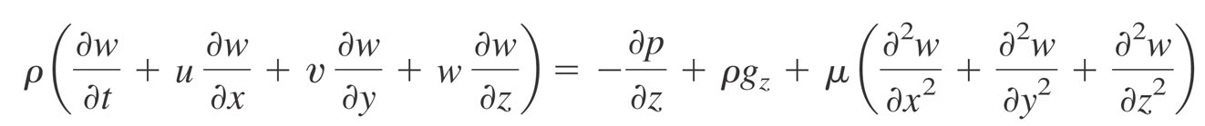
And finally….
The Navier Stokes Equations

Slide 9
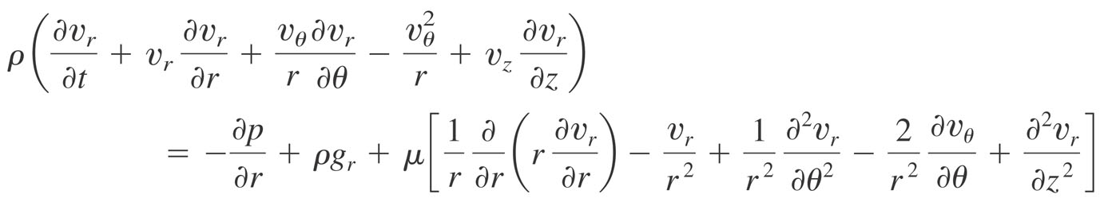
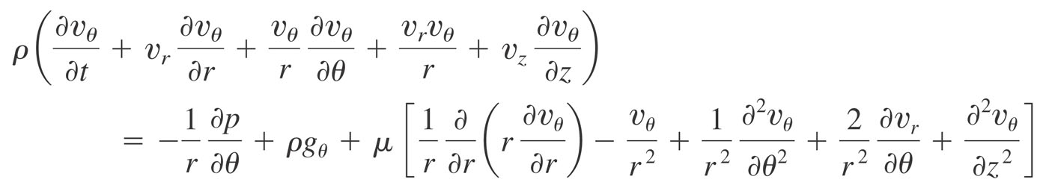
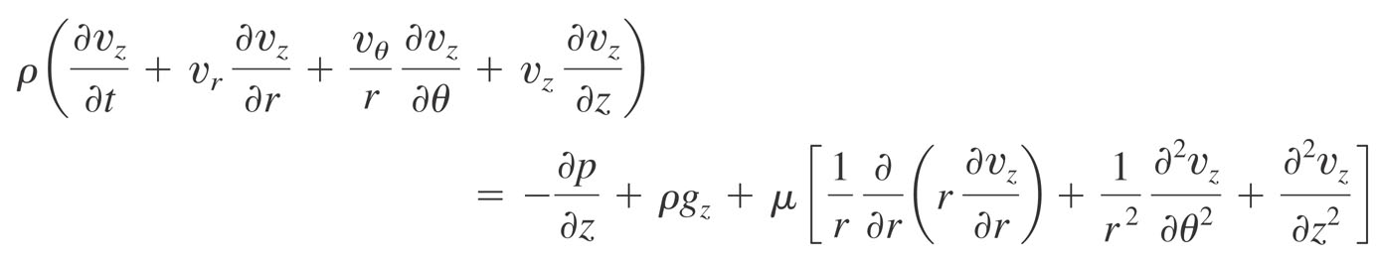
In Cylindrical Coordinates

Slide 10
So….
What can we do with these beast equations??
Let’s look for some simple solutions…..
Poiseuille Flow
Hagen-Poiseuille Flow
Couette Flow
Taylor-Couette Flow
Mixed Poiseille-Couette Flow

Slide 11
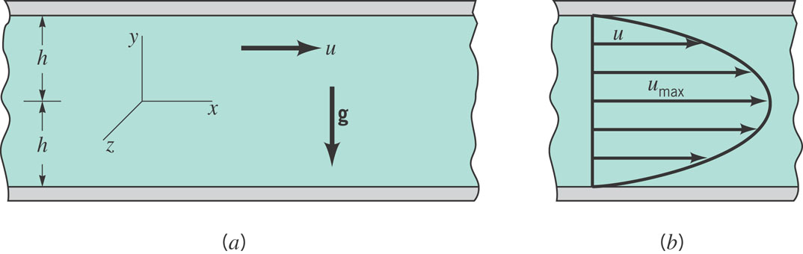
Poiseuille Flow
2-d flow between stationary plates driven by pressure drop
Let’s make some assumptions to solve this flow (you guys think about it in groups)

Slide 12
Poiseuille Flow
Let’s calculate the following things:
Velocity Profile
Mean Velocity
Maximum Velocity
Vorticity
Shear Stress

Slide 13
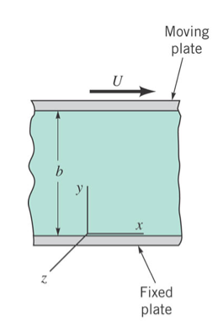
Couette Flow
2-d flow between moving plates with zero pressure drop
Again, let’s make some assumptions to solve this flow (you guys think about it in groups)

Slide 14
Couette Flow
Again, let’s calculate the following things:
Velocity Profile
Mean Velocity
Maximum Velocity
Vorticity
Shear Stress

Slide 15
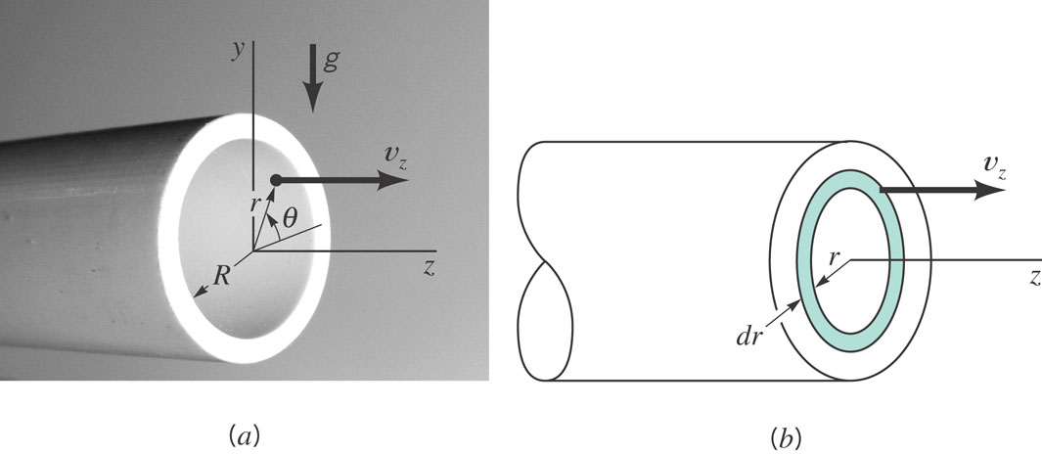
Hagen-Poiseuille
Pressure driven flow in a pipe

Slide 16
Hagen- Poiseuille Flow
Guess what? Let’s calculate the following things:
Velocity Profile
Mean Velocity
Maximum Velocity
Vorticity
Shear Stress

Slide 17

Sample Problem

Slide 18
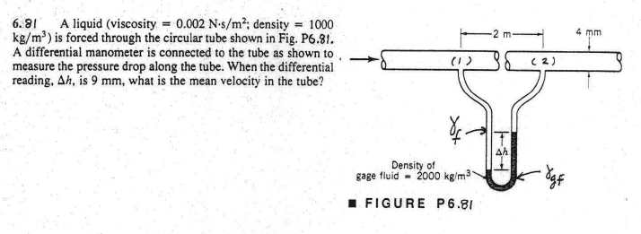
Sample Problem

Slide 19
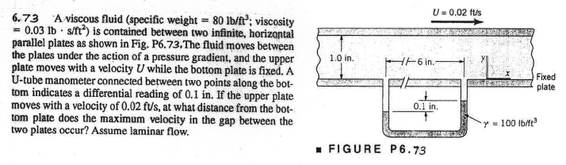
Sample Problem

Slide 20
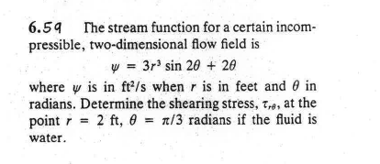
Sample Problems

Slide 21
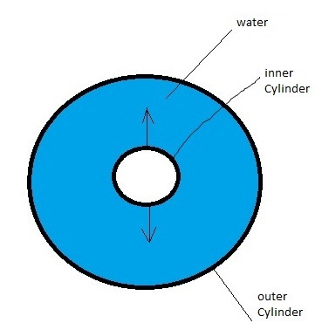
Flow Between Concentric Cylinders
Taylor-Couette Flow
Assume out cylinder rotates at angular velocity ω_{in}
Assume out cylinder rotates at angular velocity ω_{out}

